Slide 1

AIT 622- Big Data Analytics Project:
Forecasting US Stocks
Spencer Marlen-Starr

Slide 2

Source Data
My Source Data comes from a project repository on Kaggle
It consists of 5 sets of over 200 annual financial indicators for companies with stocks traded on US stock exchanges from 2014 to 2018
Each dataset has data on around 4,000 different such stocks,
although not necessarily always the same 4,000 for each year
Each dataset can accommodate both classification & regression forecasts

Slide 3
Initial Data Munging & Preprocessing
The main things I did for each of the 5 datasets were:
remove all categorical columns to prevent any run errors when fitting my models
remove all near zero variance candidate predictors
two different approaches to handling the many missing values in each
The 2 different ways I handled the missing values were the following:
I omitted (removed) all rows with at least 1 missing value for each dataset
I interpolated all such missing values using the mean values
I re-trained & tested all of my models on the two different resulting
sets of 5 datasets, the 1st set of which only had about an 8th the
number of observations as in the 2nd set which retained all of them.

Slide 4
Main R Library used for Modeling
The installable package/library I used for fitting, validating, and testing the performance of most of the models I ran during this project was the ‘caret’ package.
caret stands for classification and regression training
It is an ambitious and practically useful package which intends to standardize the syntax for training/fitting, tuning/validating, and testing/evaluating a vast multitude of machine learning methods in R
Furthermore, I also the same random value of 100 before fitting each model to ensure replicability

Slide 5
Classification Forecasting Models Used
As for Classification Models/Algorithms, I went with, I chose these 7:
• Logit • PLS-DA • Elastic Net
• Support Vector Machine • a single Artificial Neural Network
• Average (of several) Neural Nets • KNN
I chose the above of classification models mostly because they were covered in STAT 515 and/or OR 568, so I am familiar with them.

Slide 6
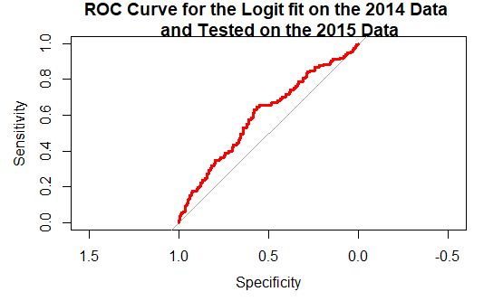
Results for the 4 Best Performing Classification Models Trained & Tested on the Datasets with NAs Omitted
Logistic Regression
Classification | Increase | Decrease
Increase | 53 | 301
Decrease | 60 | 183
 |  |  | 513
Accuracy | 40% | Kappa | -0.08
True Positive Rate | 38% | True Negative Rate | 47%
Precision | 75% | AUC | 0.6

Slide 7
Results of 4 of the 7 Classification Models
Logistic Regression
Classification | Increase | Decrease
Increase | 53 | 301
Decrease | 60 | 183
 |  |  | 513
Accuracy | 40% | Kappa | -0.08
True Positive Rate | 38% | True Negative Rate | 47%
Precision | 75% | AUC | 0.6

Slide 8
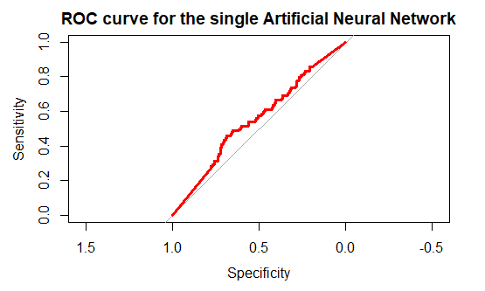
Performance Metrics for the Neural Network
Artificial Neural Network
Classification | Increase | Decrease
Increase | 51 | 252
Decrease | 62 | 232
 |  |  | 513
Accuracy | 47% | Kappa | -0.04
True Positive Rate | 48% | True Negative Rate | 45%
Precision | 79% | AUC | 0.55

Slide 9
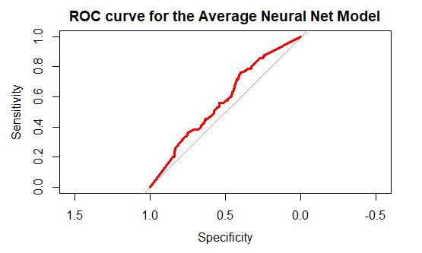
Performance Metrics for the Avg Neural Nets
Average of several Neural Nets
Classification | Increase | Decrease
Increase | 53 | 269
Decrease | 60 | 215
 |  |  | 513
Accuracy | 45% | Kappa | -0.05
TPR | 44% | TNR | 47%
Precision | 78% | AUC | 0.58

Slide 10
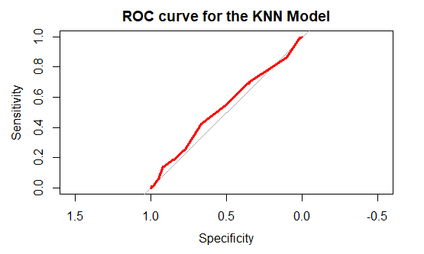
Performance Metrics for the KNN
K Nearest Neighbors
Classification | Increase | Decrease
Increase | 85 | 379
Decrease | 28 | 105
 |  |  | 513
Accuracy | 32% | Kappa | -0.014
TPR | 22% | TNR | 75%
Precision | 79% | AUC | 0.534

Slide 11
Model Assessment & Comparison
Honestly, all 7 of the Classification models used performed
atrociously by almost all of the performance metrics.
In terms of Kappa, because it should be a positive number, the model which performed least poorly was KNN because all models somehow ended up with negative Kappas, but KNN’s Kappa was the smallest in absolute value (-0.01).
In terms of accuracy, the Artificial Neural Network had the highest with 47%, but when taking into account their confidence intervals, this is not statistically different than the Avg Neural Nets 45% accuracy.

Slide 12
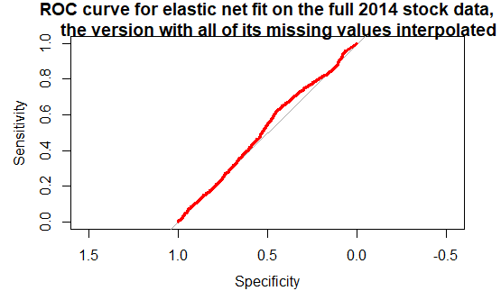
Results for Classification Models Trained, Tuned, and Tested on Datasets with all NAs Interpolated which Performed Better
Elastic Net
Classification | Increase | Decrease
Increase | 947 | 2154
Decrease | 282 | 737
 |  |  | 3808
Accuracy | 41% | Kappa | 0.02
True Positive Rate | 26% | True Negative Rate | 77%
Precision | 72% | AUC | 0.52

Slide 13
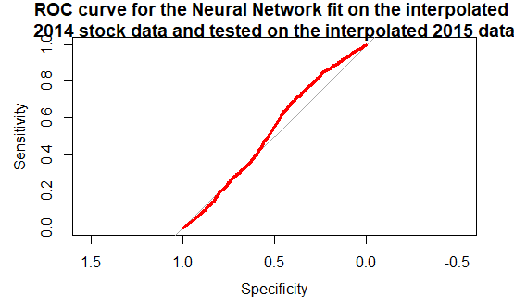
Performance Metrics for the Neural Network
Artificial Neural Network
Classification | Increase | Decrease
Increase | 1066 | 2435
Decrease | 163 | 456
 |  |  | 3808
Accuracy | 37% | Kappa | 0.02
True Positive Rate | 16% | True Negative Rate | 87%
Precision | 74% | AUC | 0.53

Slide 14
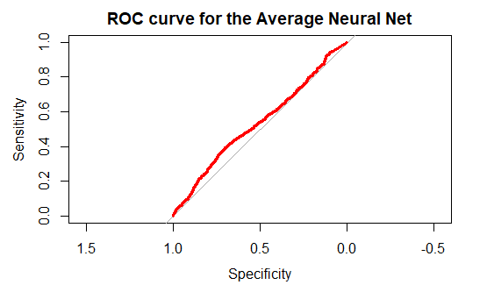
Performance Metrics for the Avg Neural Nets
Average of several Neural Nets
Classification | Increase | Decrease
Increase | 901 | 2090
Decrease | 328 | 801
 |  |  | 3808
Accuracy | 41% | Kappa | 0.007
TPR | 44% | TNR | 74%
Precision | 71% | AUC | 0.54

Slide 15
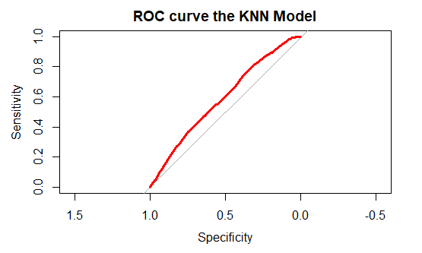
Performance Metrics for the KNN
K Nearest Neighbors
Classification | Increase | Decrease
Increase | 994 | 1999
Decrease | 235 | 892
 |  |  | 3808
Accuracy | 46% | Kappa | 0.08
TPR | 31% | TNR | 71%
Precision | 79% | AUC | 0.59

Slide 16
Best of These Re-Estimated Models
The best of the 7 re-trained, validated, and tested classification models all fit using datasets with the initial missing values interpolated rather than omitted is unequivocal: K-Nearest Neighbors model which had the highest Kappa, Accuracy, and AUC.

Slide 17
Any questions?

